Slide 1

Dungeons & Dragons Decks
Joshua hernandez

Slide 2
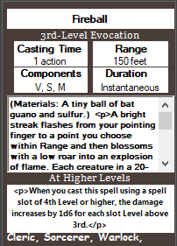
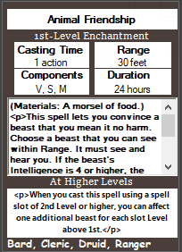
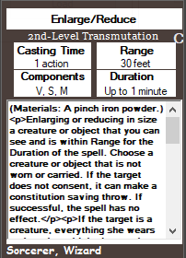
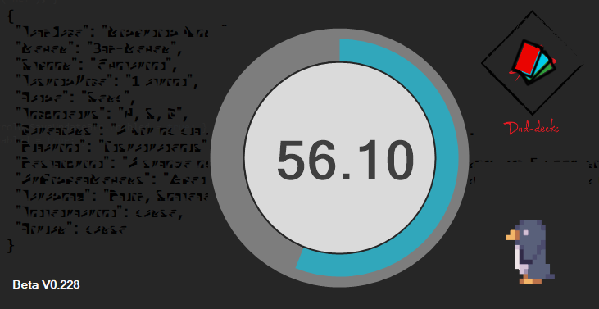
What does it do?
DnD Decks (Dungeons and Dragons Decks) is a spell card deck system. the user can create profiles to store basic data and spell cards, once the user is done he or she can simply click the save button and the program will save the profile in a Json file format.
When DnD Decks is first launched it will:
Preload the forms and 400+ spells
create spell card for each spell
show the main form and hide the preload form.
Penguin is Beta only

Slide 3

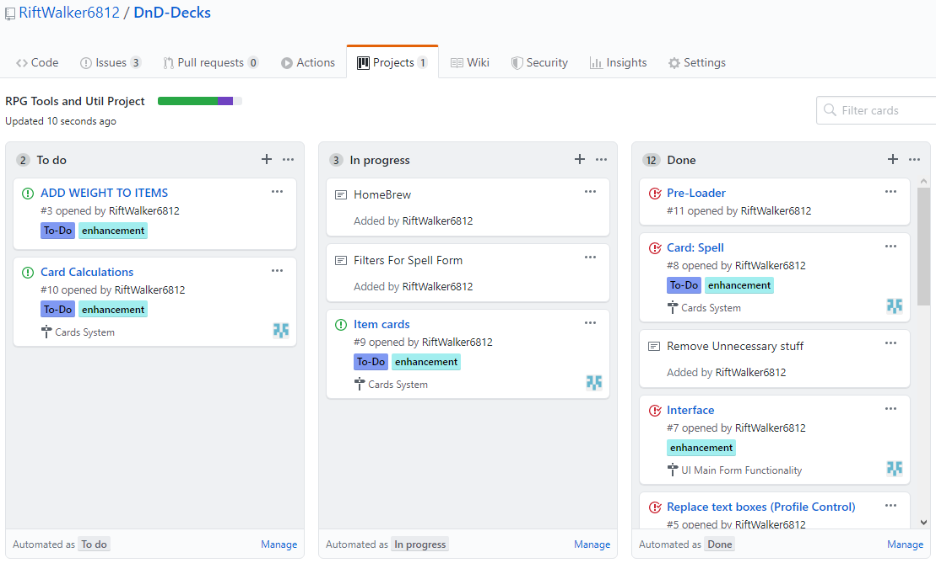
Project evolution
The project was experimented on a week before the project began to test out Json file saving. from there when the project began I planned out everything that was going in the project on GitHub. all of the issues and plans were posted and pinned on a project board and milestones were made to show progression in the project.
Gource of all changes done to repository
https://github.com/RiftWalker6812

Slide 4
project and personal goals
The goals of the project
Demonstate the use of Json files.
Save, load, and create your own spell cards.
make an easy to use program to manage many spells for DnD players.
make the program as a utilitie that people from the Dungeons and Dragons community would use, which also includes me.
The personal goals
Improve on programming research and learn about different concepts and methods of developing applications.
learn the use of library extension systems, such as Json.

Slide 5
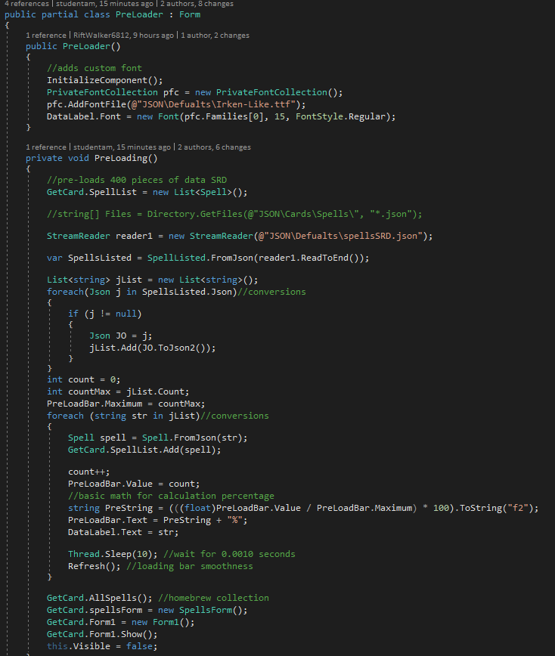
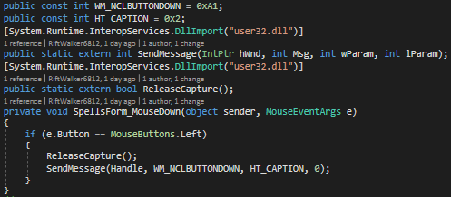
Code description and techniques
Coding technique
Lots of foreach usage due to the amount of lists there is.
Classes with json implantation
Usage if and switch statements for validation checks
Drag-able forms code implementation as shown below

Slide 6
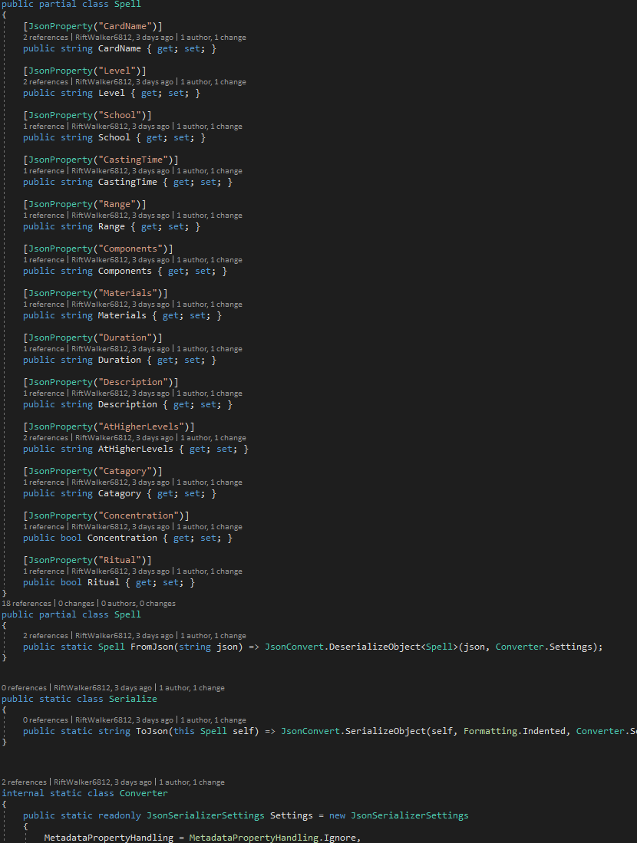
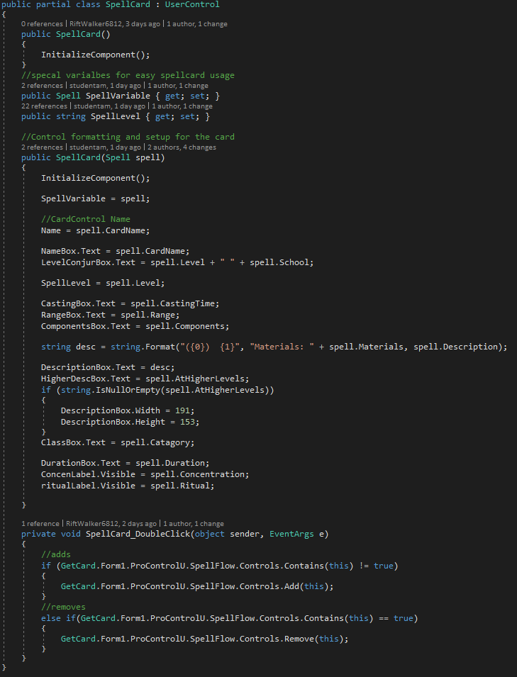
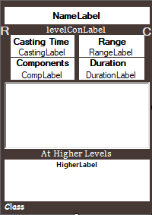
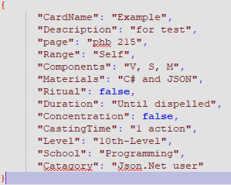
Json library usage
Json
Saves the class
Loads the class
As JSON Objects
Using System IO
Easy to read

Slide 7
Flowcharts
Application
Library's
Json
My User Controls
Circular progress bar, Winforms Animations
DnD-Decks
Pre-Loads

Slide 8
End - Lets try the beta
Developer Profile
Joshua Hernandez
Junior .NET
https://github.com/RiftWalker6812

